Slide 1






STAT 50 Sections 5.3 and 5.4
April 15, 2021

Slide 2
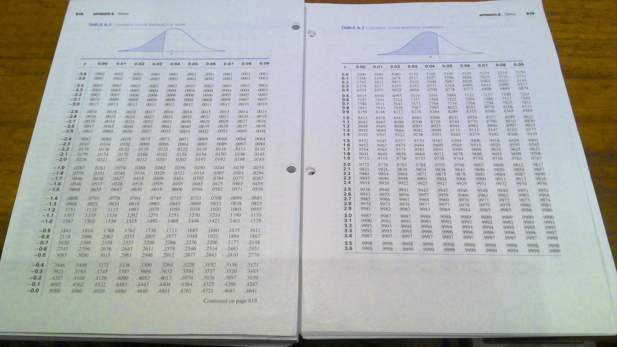

Slide 4























Slide 5










Slide 6

































Slide 7

































Slide 8
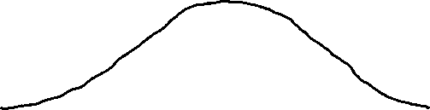


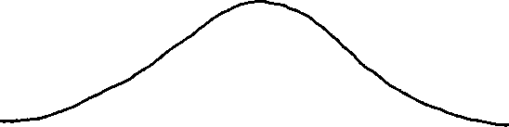















Slide 10
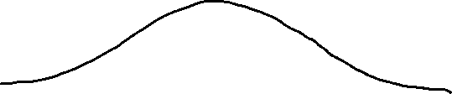







Slide 11
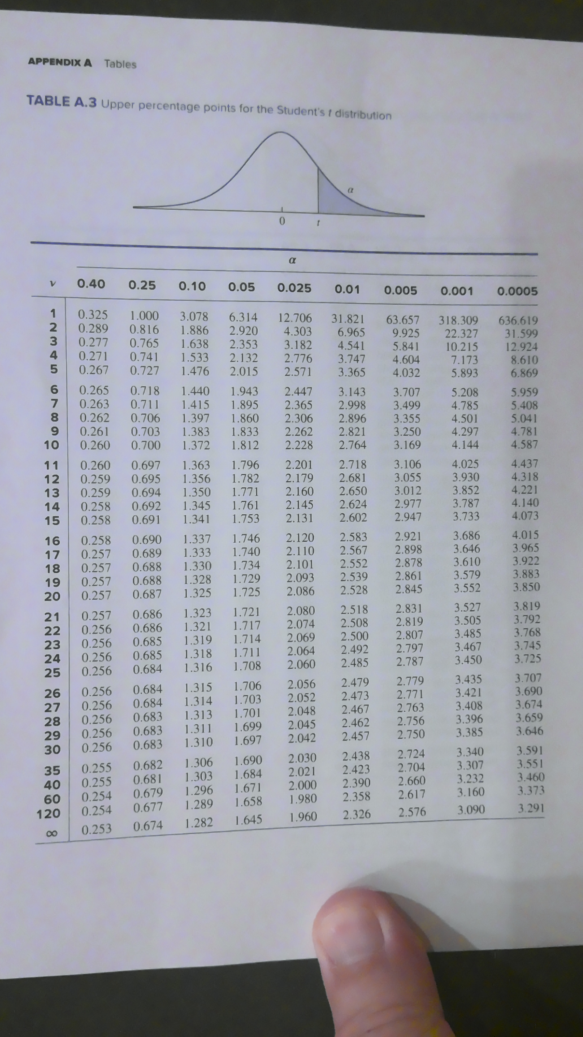

Slide 12






Slide 13






Slide 14








Slide 15






Slide 16







Slide 17



Slide 18









Slide 19



















Slide 20




Slide 21


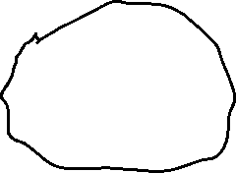


Slide 22









Slide 23













Slide 24









Slide 25












Slide 26



Slide 27




